Slide 1
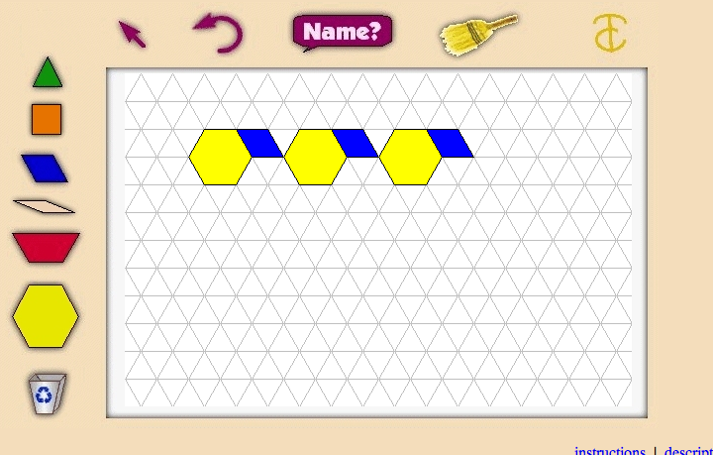
Making AB Patterns

Slide 2
Let’s create patterns
We will create 3 different AB patterns using virtual manipulatives and our SmartBoard.
Let’s get started! Click the purple link below.
Virtual Pattern blocks

Slide 3
Your Job:
Your job is to create three different AB patterns using pattern blocks.
After you create a pattern, copy the pattern onto your pattern sheet with stickers.
*HINT*Move each block and place the sticker on your paper!

Slide 4
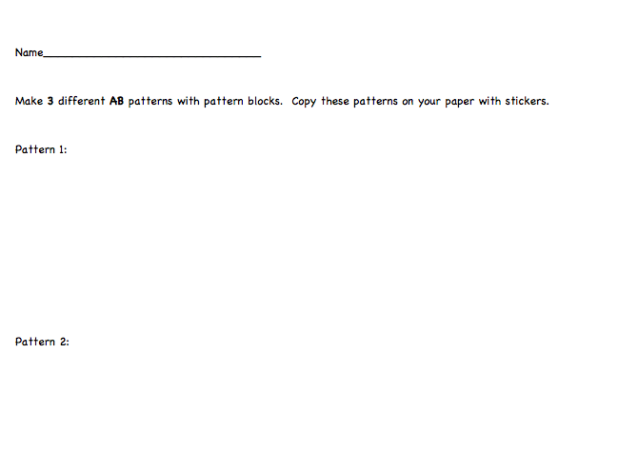


Example

Slide 5
Review!
Pick one AB pattern to share with the class.
What was hard about your job?
How else can you label the patterns you made?

