Slide 1
Patterns
Grade 1
Kerri Huntley

Slide 2
My Unit on Patterns
Audience: First Grade
Lesson 1: What is a Pattern: Pattern Hunt
Lesson 2: How to create and label patterns : AB, 1,2
Lesson 3: Labeling/ creating extension: ABAC, ABCD
Lesson 4: Naming patterns
Lesson 5: Copying and extending patterns: WebQuest quilt designer

Slide 3
How Technology was Used
Lesson length: 30-40 minutes (15-20 whole group)
Smart Notebook/ Power Point: interactive for students
WebQuest: whole class in the Computer Lab
Length of guided portion of the lesson presentation
  Attention span
  Bright, attractive colors
  Motivational tool
  Subject area

Slide 4
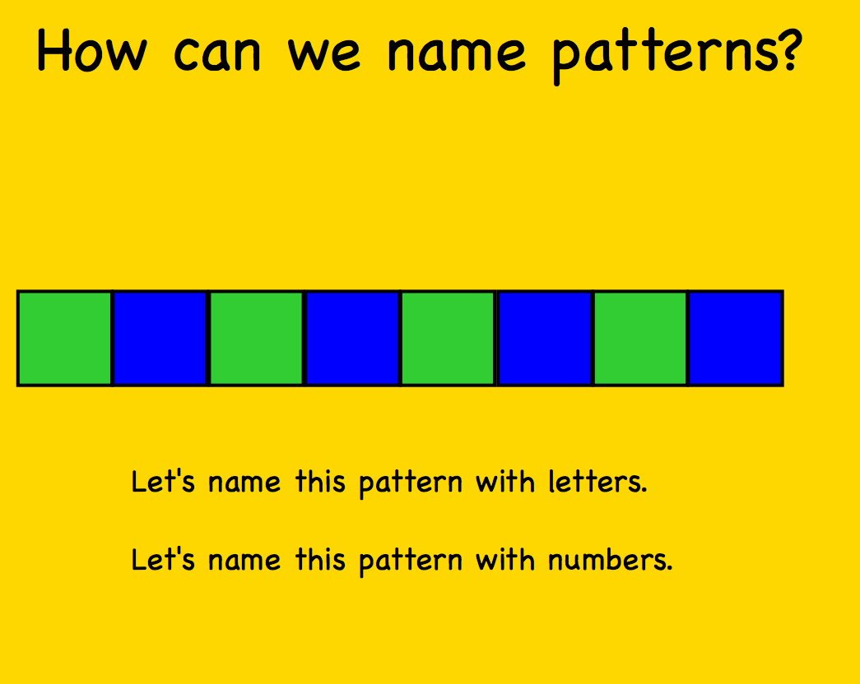
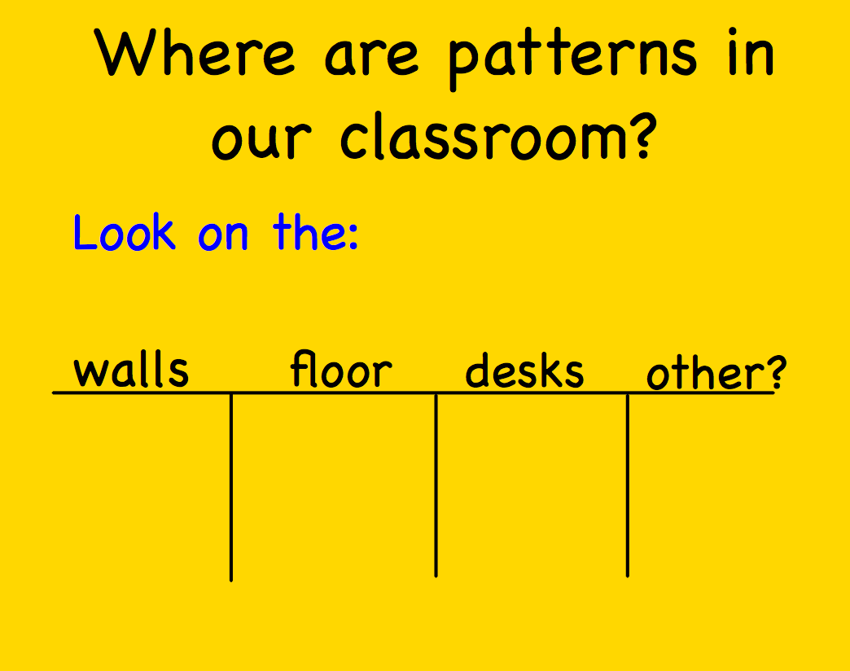
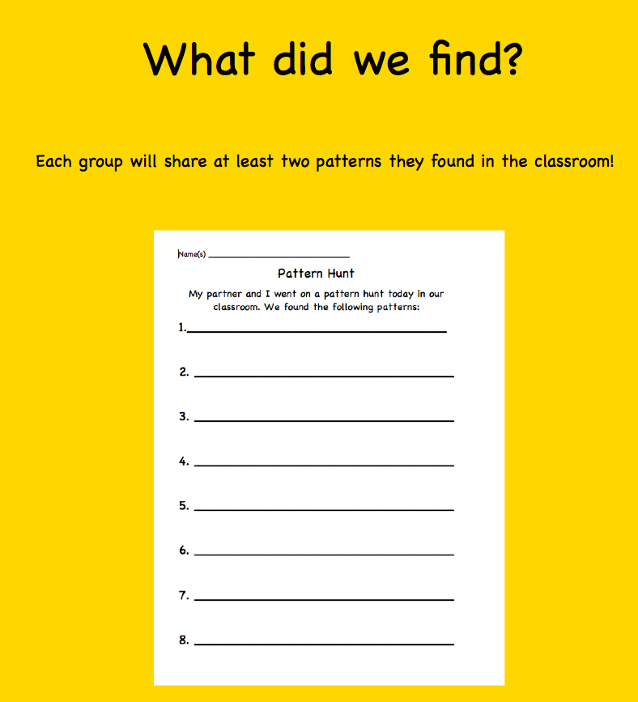
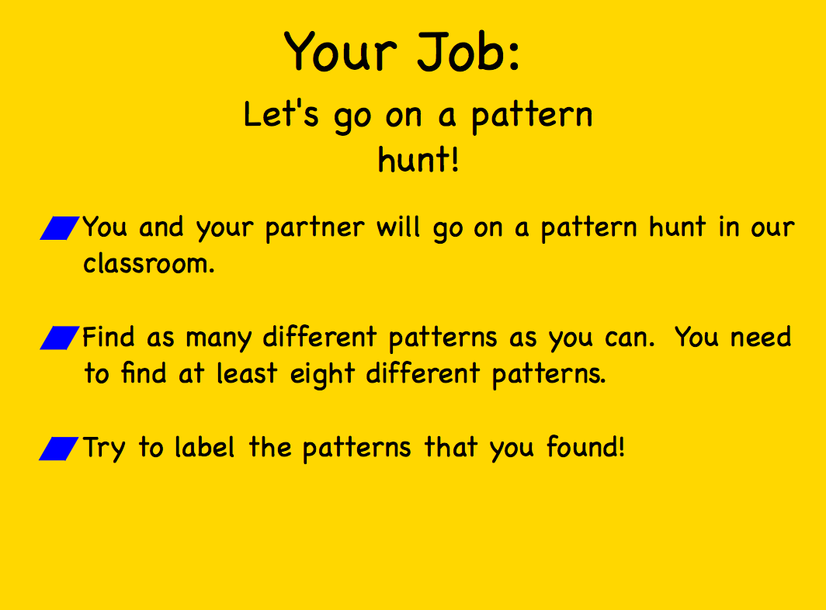
Highlights
Lesson 1:

Slide 5
Highlights
Lesson 3: Smart Notebook
Interactivity
Infinite cloner
Screen shot of a model for independent work
Review matching game

Slide 6
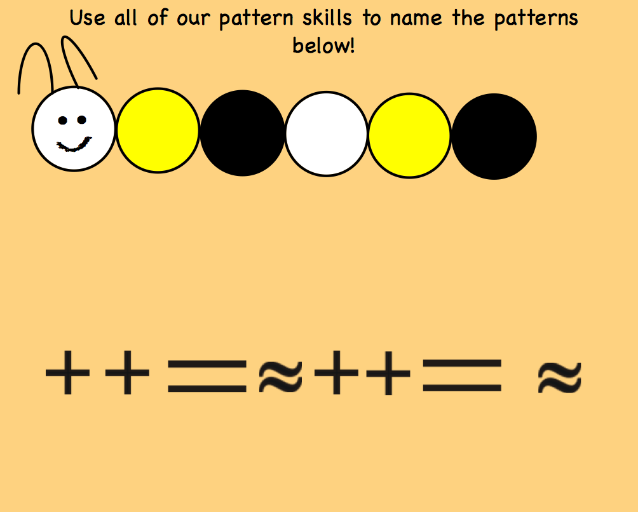
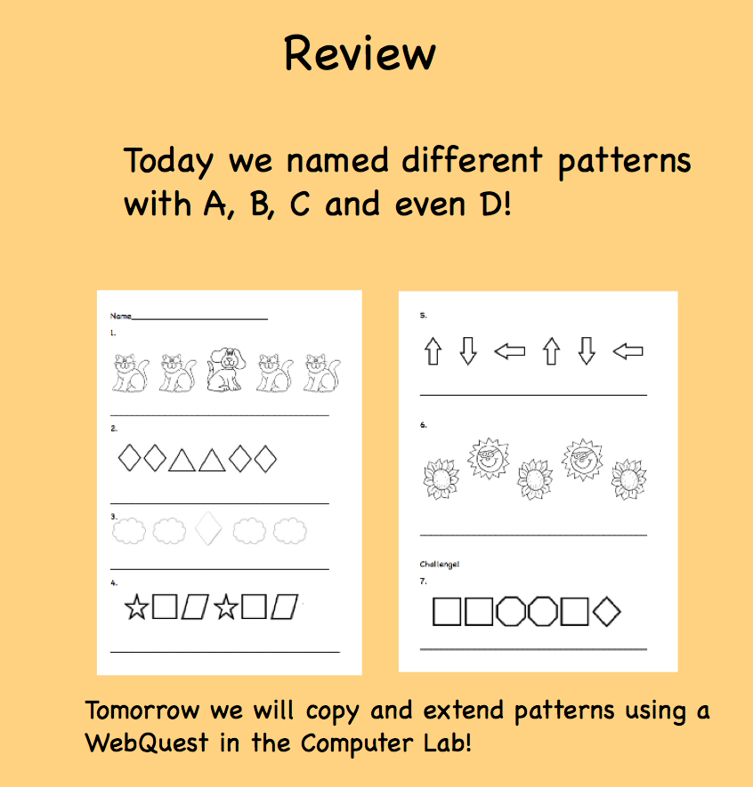
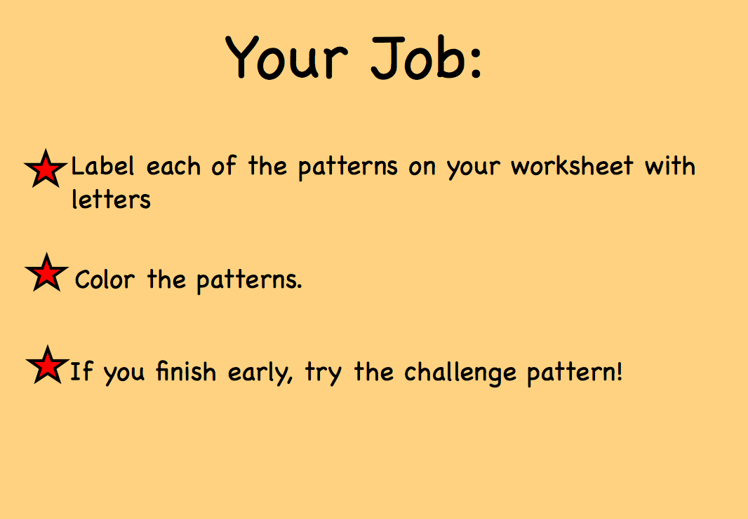
Highlights
Lesson 4:

Slide 7
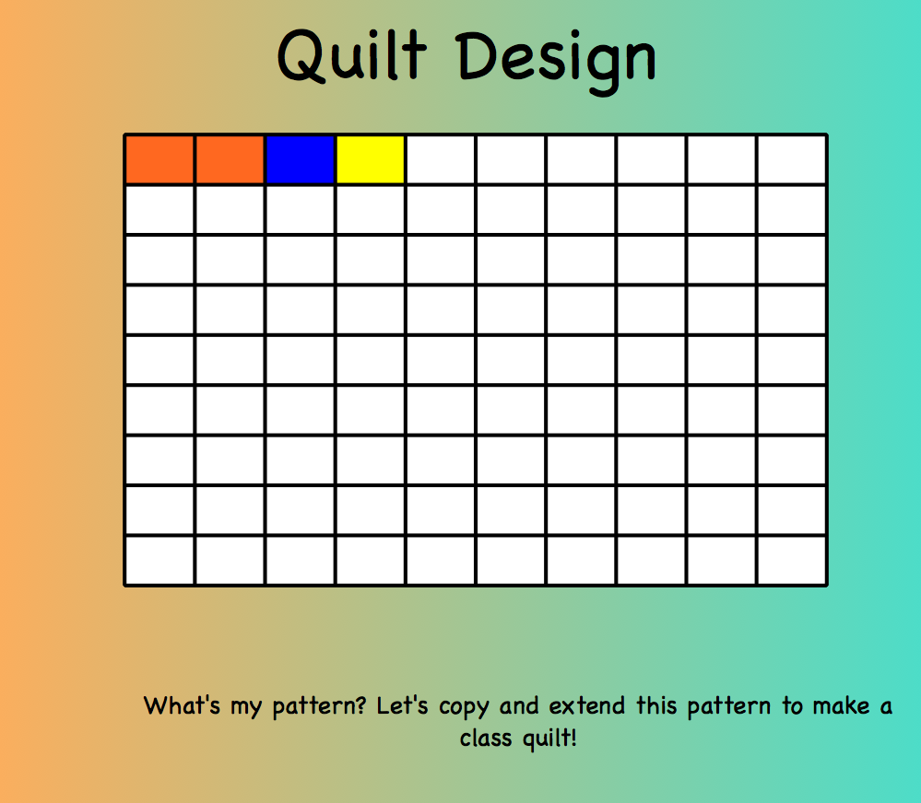
Highlights
Lesson 5:
WebQuest
Brief Smart Notebook

